Slide 1

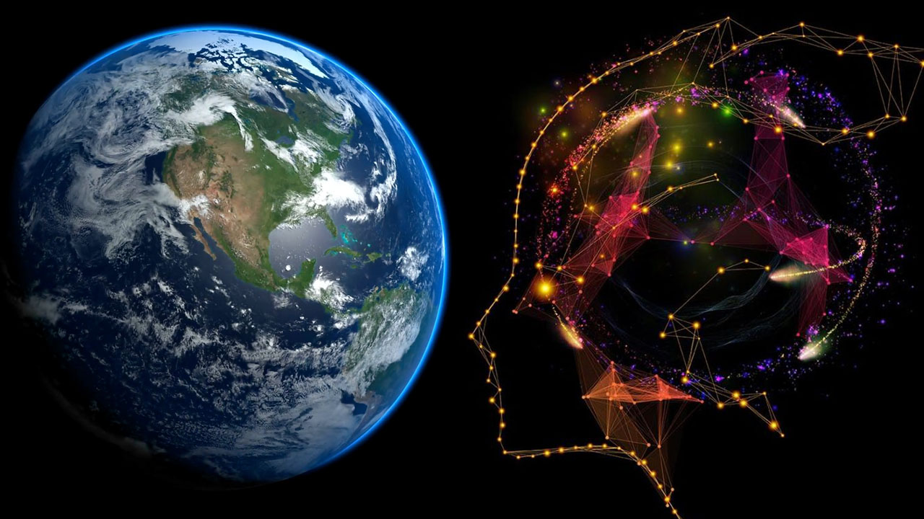
Spatial Machine Learning
Deep Learning for Spatial Data
Dr. Giri Rajasekhar Gunnu
Professor of Practice, Andhra University
📧 g.giri.iitm@gmail.com
🔗 LinkedIn: girigunnu

Slide 2
Convolutional Neural Networks (CNNs) for Spatial Data
1

Slide 3
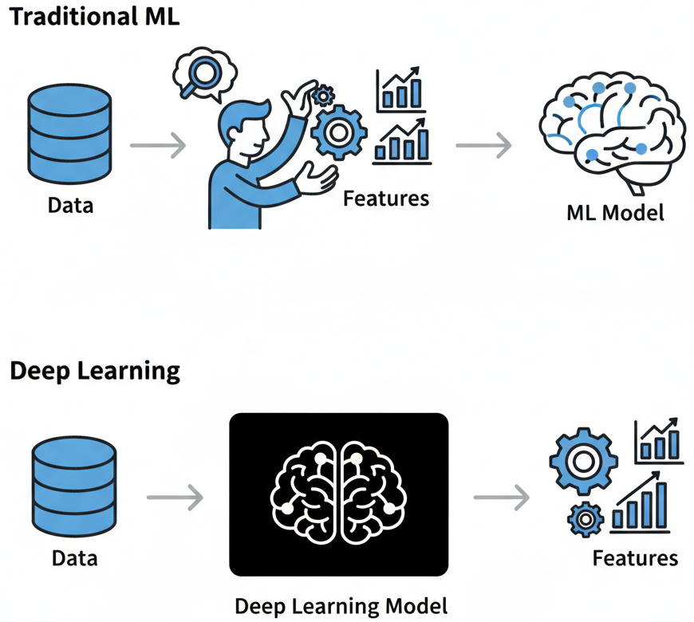
Why Deep Learning? A Leap Beyond Traditional ML
Concept: While traditional ML relies on hand-crafted features (Chapter 2), Deep Learning models perform automatic feature extraction. They learn the best features directly from the raw data.
Why we learn this: For complex spatial data like satellite imagery, manually defining features that capture texture, context, and spectral signatures is incredibly difficult. Deep Learning automates this discovery process.
Real-World Connection: This allows us to tackle problems at a scale and complexity previously unimaginable, such as identifying thousands of individual trees in a drone image or detecting subtle changes in polar ice sheets from SAR data.

Slide 4
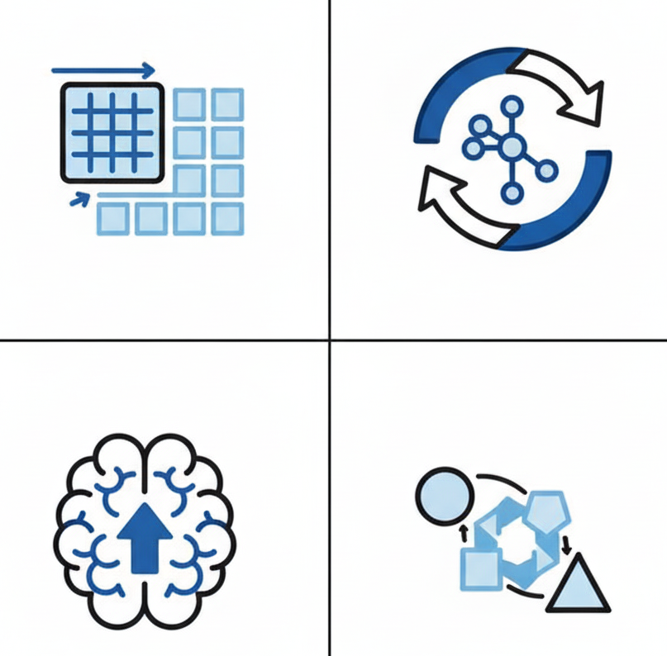
Learning Objectives
Objective 1 (CNNs): Implement Convolutional Neural Networks to classify image-based spatial data (e.g., remote sensing imagery).
Objective 2 (RNNs): Understand and apply Recurrent Neural Networks for analyzing spatiotemporal sequences.
Objective 3 (Transfer Learning): Leverage pre-trained models to achieve high performance on geo-informatics tasks with limited labeled data.
Objective 4 (Ensembles): Combine multiple deep learning models to boost predictive accuracy and robustness.

Slide 5

Syllabus Overview
Convolutional & Recurrent Neural Networks: The architectural cornerstones for spatial image and sequence data.
Spatiotemporal Modeling: Explicitly modeling the dynamics of "space" and "time" together.
Spatial Ensemble Methods: The art of combining models to create a more powerful whole.

Slide 6
Convolutional Neural Networks (CNNs)
Title: CNNs: The Eyes of Deep Learning
Subtitle: Learning Hierarchical Features from Gridded Spatial Data

Slide 7
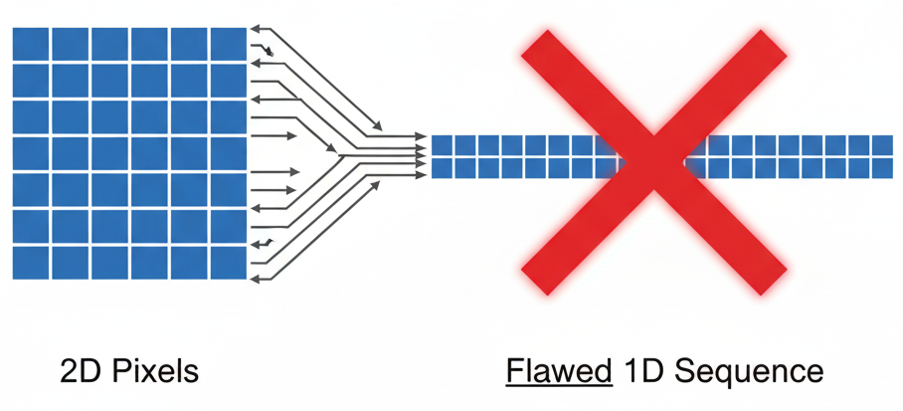
The Problem with Standard Networks for Images
Concept: A standard, fully-connected neural network "flattens" an image into a 1D vector. A 1000x1000 pixel image becomes a 1,000,000-element vector, leading to billions of parameters.
Key Failures:
Computationally Explosive: Too many parameters to train effectively.
Loses Spatial Structure: The network has no idea which pixels were originally next to each other. It loses all spatial context.

Slide 8
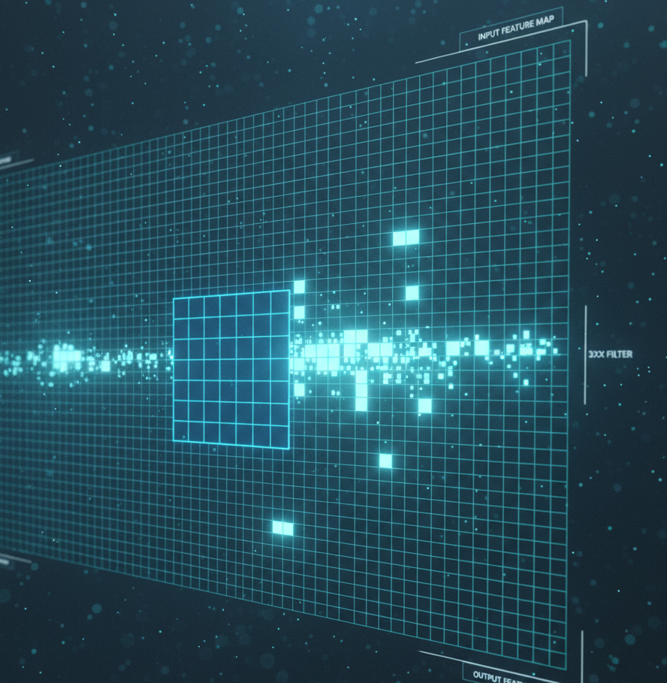
The CNN Solution: The Convolution Operation
Concept: The core of a CNN. A small matrix called a filter (or kernel) slides over the input image. At each position, it performs a dot product, creating a feature map.
Why we learn this: This operation preserves the spatial relationship between pixels and allows the network to learn features that can appear anywhere in the image (translation invariance).
Geo-Informatics Application: A filter can learn to become a "coastline detector" in a satellite image or a "crevasse detector" in a SAR image of a glacier.

Slide 9
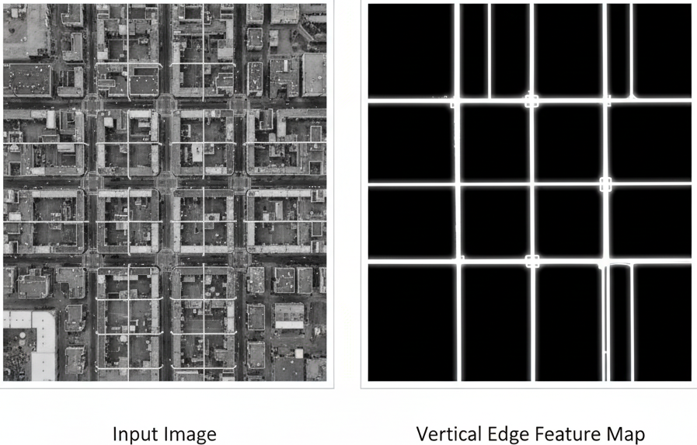
Visualizing Convolution: Edge Detection
Example: Imagine a 3x3 filter designed to detect vertical edges. When it slides over a part of an image that has a sharp vertical change in pixel values (like the edge of a building in a RADAR image), the dot product results in a high value. Where the image is uniform, the result is zero.
The Feature Map: The resulting feature map is a new image that highlights all the vertical edges. The CNN learns the optimal values for these filters automatically.

Slide 10
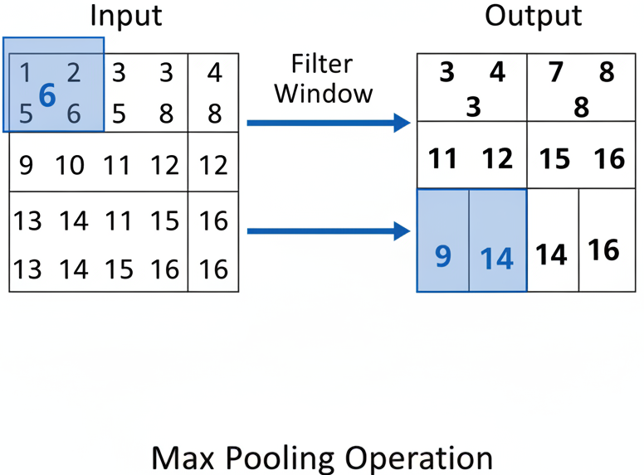
CNN Architecture: The Pooling Layer
Concept: A pooling (or subsampling) layer is typically added after a convolution layer. It reduces the spatial dimensions (height and width) of the feature map.
Common Method: Max Pooling. A small window (e.g., 2x2) slides over the feature map and, in each position, outputs only the maximum value.
Why we learn this: Pooling makes the model more computationally efficient and helps it become robust to small variations in the position of features.

Slide 11
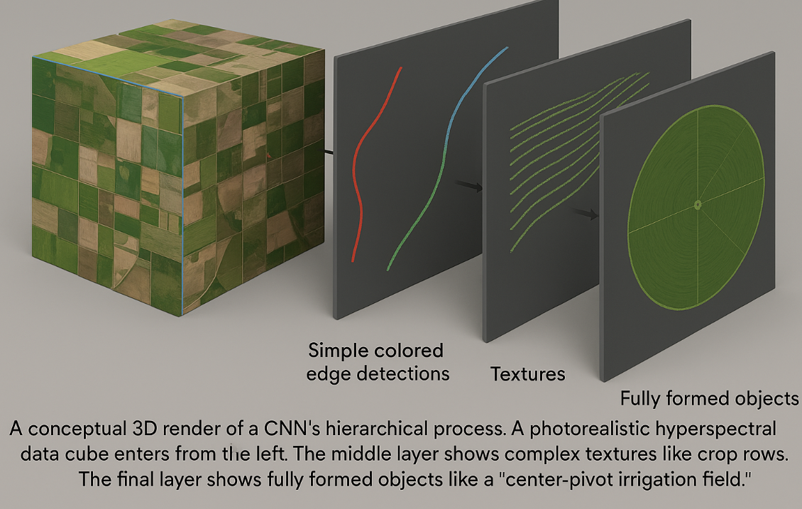
Hierarchical Feature Learning
Concept: CNNs stack multiple convolution and pooling layers.
Early Layers (Shallow): Learn simple features like edges, corners, and color gradients.
Mid Layers: Combine these simple features to learn more complex patterns like textures (e.g., the texture of a forest canopy vs. a paved surface).
Deep Layers: Combine textures and patterns to learn to identify entire objects or concepts (e.g., "airport," "residential area," "landslide scar").

Slide 12
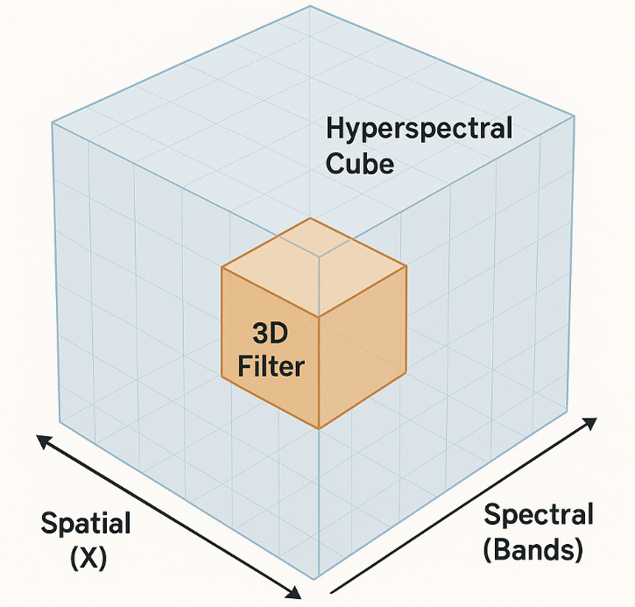
Application: CNNs on Hyperspectral Images
Geo-Informatics Data: Hyperspectral sensors capture hundreds of narrow spectral bands, creating a data "cube" (Width x Height x Bands). This is far richer than simple RGB.
CNN Approach: We can use 3D CNNs that use 3D filters (e.g., 3x3x5) to convolve not just over space (the 3x3) but also over the spectral dimension (the 5).
Why it's powerful: A 3D CNN can learn complex spectro-spatial features, like the unique signature of a specific mineral deposit that is defined by both its shape and its specific combination of spectral responses.

Slide 13
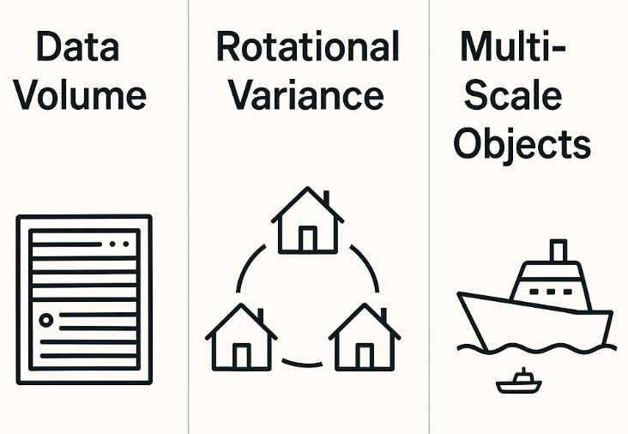
Challenges with CNNs on Geo-Data
Challenge 1: Data Volume & Dimensionality.
Challenge 2: Rotational Variance.
Challenge 3: Multi-Scale Objects.

Slide 14
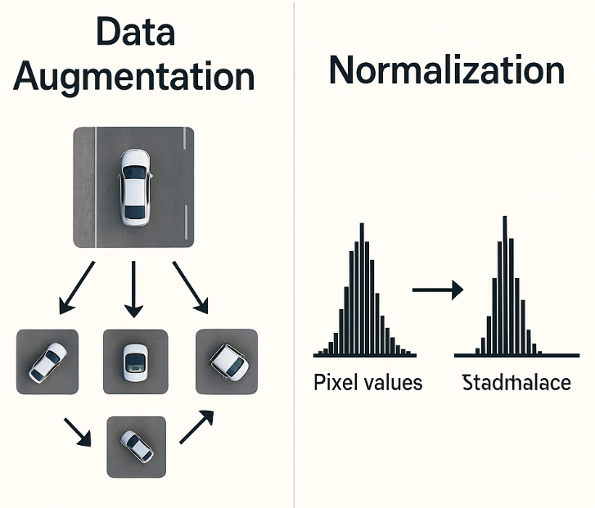
Best Practices & Precautions
Best Practice 1: Data Augmentation. Artificially increase your training dataset by applying transformations: random rotations, flips, zooms.
Best Practice 2: Normalization. Scale pixel values from all bands to a standard range (e.g., 0 to 1). This is crucial for stable training.

Slide 15
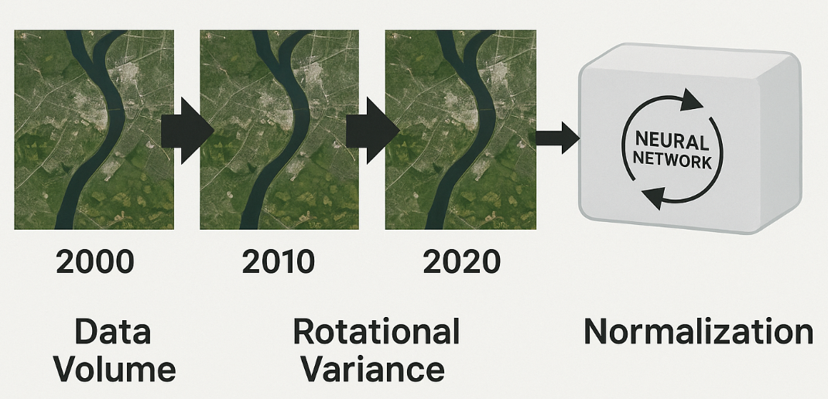
Recurrent Neural Networks (RNNs)
Title: RNNs: The Memory of Deep Learning
Subtitle: Modeling Sequences and Time in Spatiotemporal Data

Slide 16
Why We Need a Different Architecture for Sequences
Concept: CNNs have no inherent memory of past inputs. To predict deforestation tomorrow, you need to know its state yesterday and the day before.
Geo-Informatics Application: Analyzing time series of Landsat images, daily soil moisture measurements, or the track of a hurricane.

Slide 17
The RNN Architecture: The Feedback Loop
Concept: The core idea of an RNN is a feedback loop. When the network produces an output at time step t, it feeds that information back into itself to influence the prediction at time step t+1.
Mechanism: This loop creates a "hidden state" or "memory" that acts as a summary of the past sequence, allowing information to persist.
Why we learn this: This is the fundamental architecture that allows models to understand context and order in a temporal sequence, moving beyond the "one-shot" predictions of CNNs.

Slide 18
The Problem of Long-Term Dependencies
Challenge: Vanishing Gradients. In a simple RNN, as a sequence gets longer, the "memory" of the early events can fade. The signal (gradient) used for training becomes exponentially smaller as it's propagated back through time, making it impossible to adjust weights based on early events.
Geo-Informatics Application: In a 30-year land-use time series, a simple RNN might "forget" that a major fire in year 3 is the primary reason for the slow forest regrowth seen in year 25.
Real-World Connection: This failure to capture long-range dependencies is a critical limitation for analyzing long-term climate data, historical urban growth, or glacial retreat.

Slide 19
The Solution: Long Short-Term Memory (LSTM) Networks
Concept: LSTMs are a specialized type of RNN designed specifically to combat the vanishing gradient problem and learn long-term dependencies.
How: Each LSTM cell is more complex, containing a dedicated "cell state" (a memory conveyor belt) and a system of "gates" that regulate information flow.
Forget Gate: Decides what information to throw away from the cell state.
Input Gate: Decides which new information to store in the cell state.
Output Gate: Decides what to output based on the cell state.
Why this is a breakthrough: These gates allow the network to learn to selectively remember important events for thousands of time steps.

Slide 20
LSTM Application: Crop Yield Prediction
Geo-Informatics Data: A time series of weekly Sentinel-2 satellite images (providing NDVI) and weather station data (precipitation, temperature) for an agricultural region over a full growing season.
Model: An LSTM model processes this sequence of multi-modal data week-by-week.
Prediction: At the end of the season, the model predicts the final crop yield (e.g., in bushels per acre). The LSTM's "forget gate" might learn to ignore a single cloudy day's image, while its "input gate" learns to remember a prolonged drought period, correctly weighting its impact on the final yield.

Slide 21
Challenges and Best Practices for RNNs/LSTMs
Challenge 1: Data Preparation. Spatiotemporal data must be structured into uniform sequences (e.g., [samples, timesteps, features]). Handling missing data (e.g., due to cloud cover in satellite images or sensor failure) is a major preprocessing task requiring imputation or masking.
Challenge 2: Computational Cost. Training LSTMs is computationally intensive due to their sequential nature, which is harder to parallelize than CNNs.
Best Practice: Use Bidirectional LSTMs. For some problems (not forecasting), allowing the model to process the sequence both forwards and backwards can provide richer context and improve accuracy.

Slide 22
Leveraging Pretrained Models for Geo-Informatics
Transfer Learning

Slide 23
The Core Idea of Transfer Learning
Concept: A machine learning method where a model developed for a general task (e.g., classifying millions of web photos) is reused as the starting point for a model on a specific, related task.
Why we learn this: Training state-of-the-art deep learning models from scratch requires enormous datasets and computational budgets. In geo-informatics, labeled datasets are often small and expensive to create. Transfer learning allows us to achieve high performance with limited resources.
Real-World Connection: It's the difference between training a new intern from day one versus hiring an experienced professional. We leverage existing expertise to solve our problem faster and more effectively.

Slide 24
How Transfer Learning Works with CNNs
Recall Hierarchical Features: Early CNN layers learn generic features (edges, textures), while later layers learn task-specific features.
The Strategy (Fine-Tuning):
Take a powerful CNN (like ResNet50) pre-trained on a massive dataset like ImageNet.
Freeze the weights of the early convolutional layers. We are borrowing their powerful, generic feature extractors.
Remove the original final classification layers (which identify cats, dogs, etc.).
Add new, trainable classification layers on top, tailored to our geo-informatics classes (e.g., 'wetland', 'urban', 'farmland').
Train only these new layers on our smaller, specific dataset.

Slide 25
Application: Classifying SAR Imagery
Geo-Informatics Data: Synthetic Aperture Radar (SAR) images measure surface texture and structure, making them invaluable for seeing through clouds and at night.
The Challenge: Can a model pre-trained on RGB photos be useful for grayscale SAR data, which represents radar backscatter, not visible light?
The Surprising Answer: Yes! The foundational features of our world—edges, textures, corners, and shapes—are universal. An urban area has a grid-like texture in both optical and SAR images. Transfer learning allows the model to leverage this learned "understanding of shape" and apply it to a new domain.
Real-World Connection: This enables rapid development of models for urgent tasks like damage assessment after an earthquake or flood detection from SAR images, where large labeled SAR datasets don't exist.

Slide 26
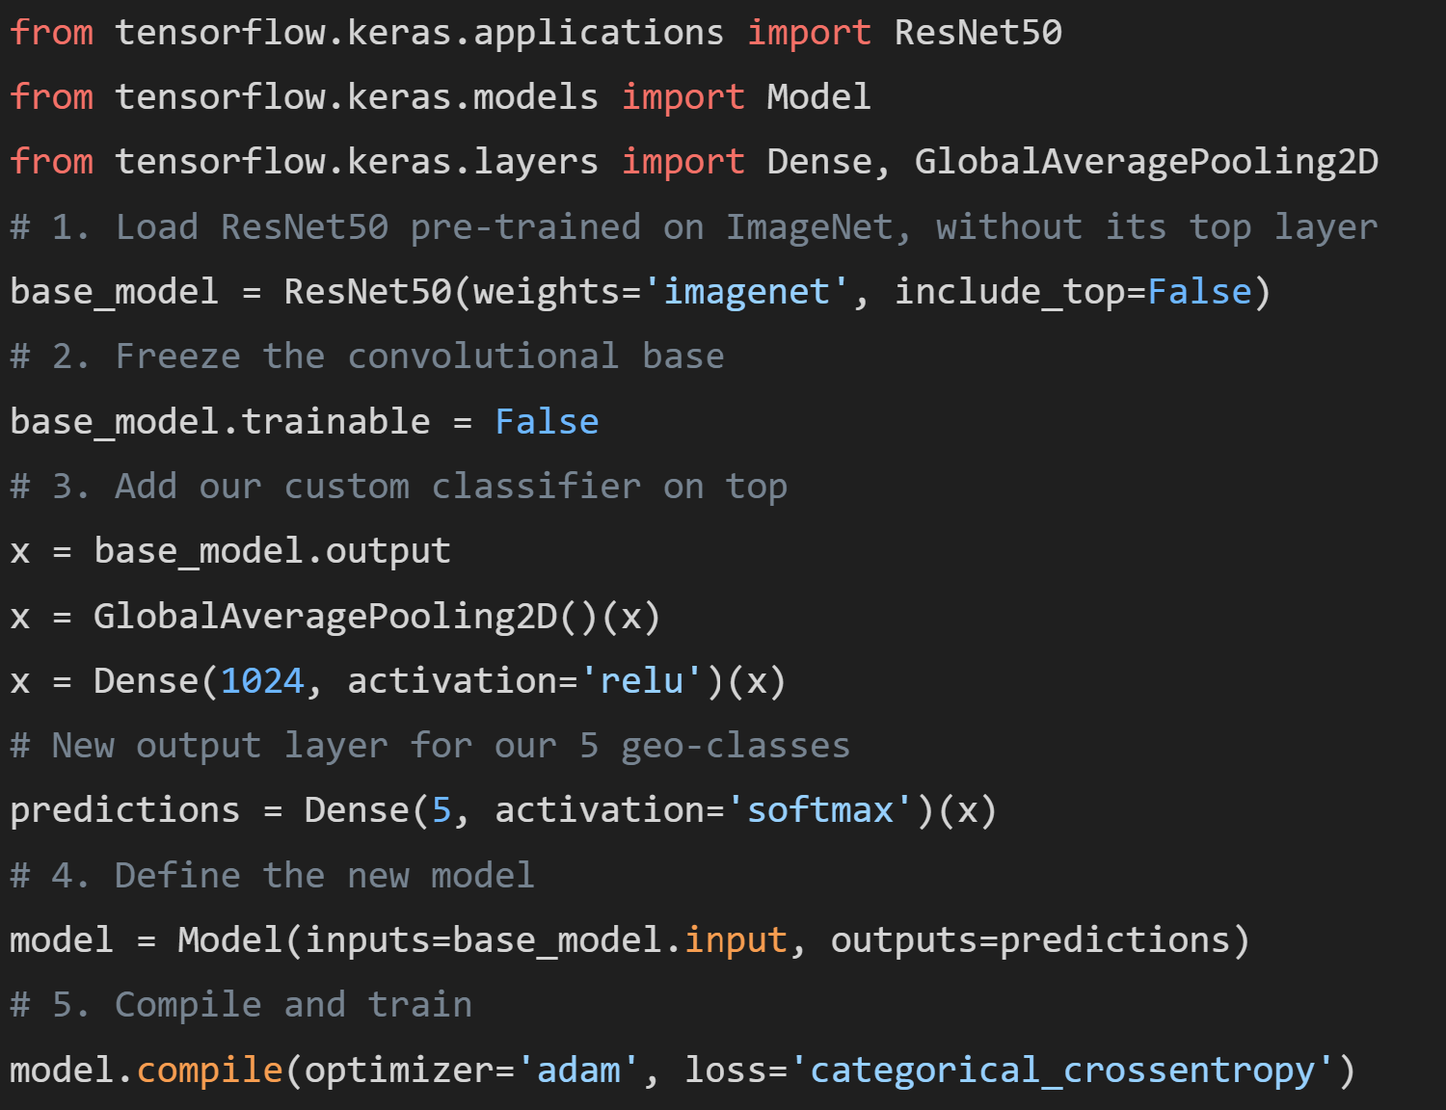
Python Code Snippet: Transfer Learning with Keras
Implementing Fine-Tuning with TensorFlow/Keras

Slide 27
The Importance of Data Normalization for Transfer Learning
Challenge: Domain Shift. Pre-trained models expect input images to be normalized in the exact same way as their original training data (e.g., pixel values scaled to a specific range, specific mean/std subtraction). Satellite data (e.g., 12-bit or 16-bit) has a vastly different native range.
Best Practice: This is a critical, non-negotiable step. You must preprocess your geospatial data to match the model's expectations. For a 12-band multispectral image, you might have to select 3 bands, stretch their values to the 0-255 range, and then apply the specific normalization function provided by the model's library.
Consequence of Failure: Feeding improperly normalized data is like speaking the wrong language to the model; the results will be nonsensical.

Slide 28
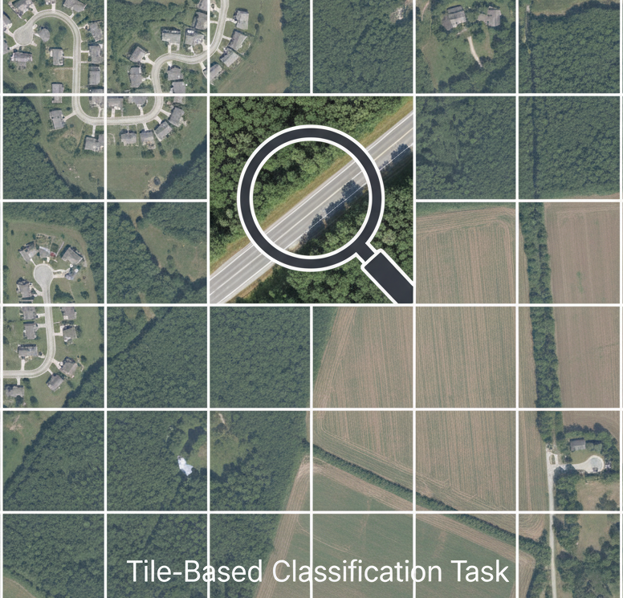
Case Study Setup: Road Detection from Aerial Imagery
Objective: Automatically map road networks from high-resolution aerial photographs for infrastructure monitoring.
Data: A dataset of 10,000 aerial image tiles (256x256 pixels), each labeled via a binary classification: "contains road" or "no road."
Method: We will use a ResNet50 model, pre-trained on ImageNet, and fine-tune it on our specific road imagery dataset.

Slide 29
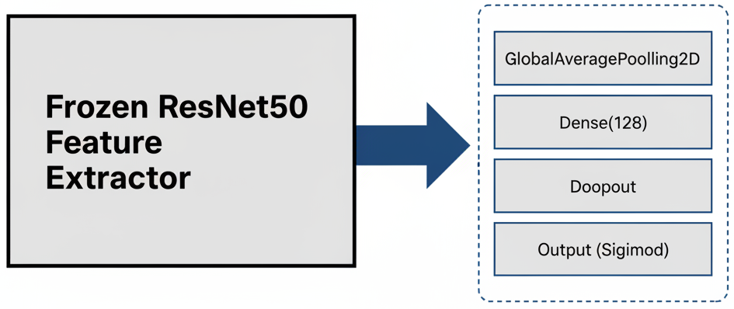
Case Study: Model Architecture
Base Model: ResNet50 (with its convolutional layers frozen).
Custom Head (Classifier):
GlobalAveragePooling2D(): Reduces the large feature maps from ResNet into a single feature vector per image.
Dense(128, activation='relu'): A hidden layer to learn combinations of the features.
Dropout(0.5): A regularization technique to prevent overfitting.
Dense(1, activation='sigmoid'): The final output layer for our binary ('road' vs. 'no road') classification.

Slide 30
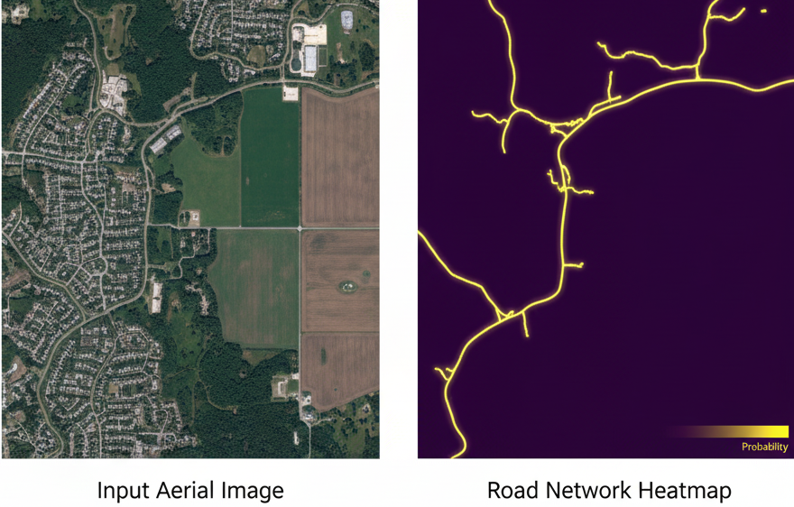
Transfer Learning: Summary
Why: It is the most practical and resource-efficient way to apply deep learning to many geo-informatics problems, overcoming the challenge of limited labeled data.
How: By freezing the generic feature extraction layers of a pre-trained model and fine-tuning a new classifier for our specific spatial task.
Geo-Informatics Power: Unlocks state-of-the-art performance for a wide range of remote sensing tasks, even with non-standard data like SAR or aerial imagery.
Critical Precaution: You MUST understand and replicate the specific data normalization procedure that the pre-trained model expects.

Slide 31
Summary of Section 1: Architectures for Spatial Data
CNNs are the standard for gridded/image spatial data, using convolutions to learn spatial hierarchies of features from imagery like RADAR, SAR, and hyperspectral data.
RNNs/LSTMs are the standard for sequential spatiotemporal data, using a feedback loop to maintain a memory of past events in time series like climate records or sensor data.
Transfer Learning is a powerful technique that adapts models from general domains to specific geospatial tasks, drastically reducing data and computation requirements.

Slide 32
Grand Challenges in Spatial Deep Learning
Labeled Data Scarcity: Obtaining large, high-quality, labeled datasets for geo-informatics tasks is the single biggest bottleneck and is extremely expensive and time-consuming.
Geo-Registration & Alignment: In time series analysis, even minor misalignments between images due to sensor wobble or different projections can completely mislead a model.
Explainable AI (XAI): Deep learning models are "black boxes." Understanding why a model classified a specific patch of land as "high risk for landslide" is a major challenge but is crucial for trust and decision-making.

Slide 33
Spatiotemporal Modeling

Slide 34
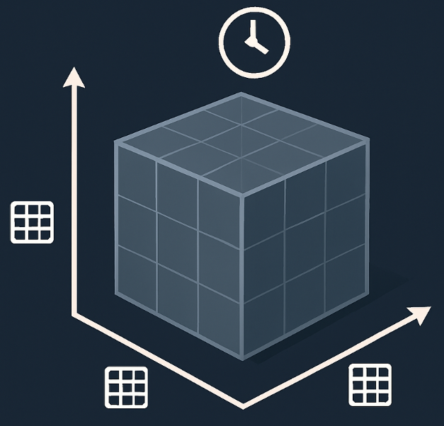
What is Spatiotemporal Data?
Definition: Data that has three dimensions: two for space (e.g., latitude, longitude) and one for time. It describes a phenomenon that exists at a specific location and changes over time.
Structure: It can be thought of as a time series of spatial datasets or a data cube.
Why we learn this: Many of the most critical and complex real-world processes are spatiotemporal, from climate change to traffic flow to the spread of a disease. Modeling this data is essential for forecasting and intervention.

Slide 35
Geo-Informatics Examples of Spatiotemporal Data
Data Source | Phenomenon | Real-World Application
🛰️ GOES Satellite | ☁️ Hourly cloud cover & 🌡️ temperature maps | ⚡ Short-term weather forecasting (nowcasting)
📡 Sentinel-1 SAR | 📶 Bi-weekly radar backscatter images | 🏙️ Monitoring ground subsidence / 🧊 Glacier movement analysis
🚗 GPS Trajectories | 📍 Minute-by-minute vehicle locations | 🚦 Urban traffic prediction & 🚍 transportation planning
🌍 Climate Models | 🌊 Monthly sea surface temperature fields | 📈 Long-term climate change impact assessment

Slide 36
The Challenge: Capturing Both Dependencies
A successful spatiotemporal model must learn two things simultaneously:
patial Dependency: The relationship between a pixel and its neighbors at the same point in time (e.g., a high-pressure area is surrounded by other high-pressure areas). This is a job for CNNs.
Temporal Dependency: The relationship between a pixel and its own past values over time (e.g., the temperature at this location today is related to the temperature here yesterday). This is a job for RNNs/LSTMs.
The Goal: We need a hybrid architecture that combines the strengths of both.

Slide 37
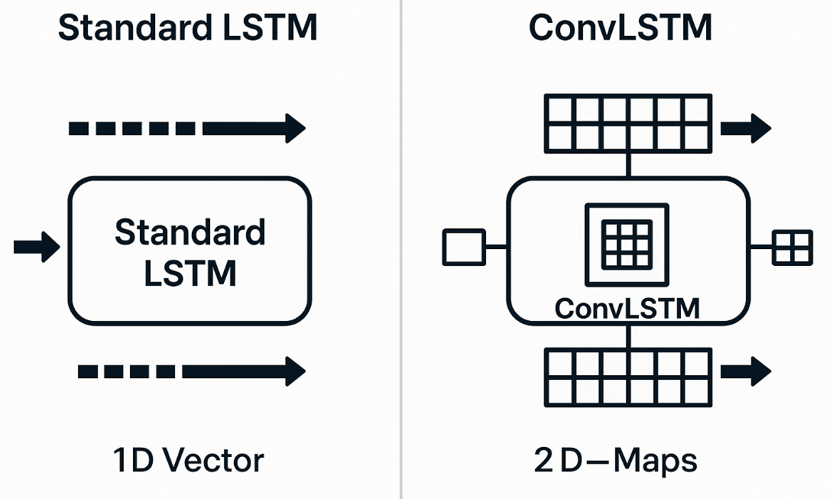
Introducing the Convolutional LSTM (ConvLSTM)
Concept: The ConvLSTM is a specialized recurrent neural network layer designed to solve this exact problem. It is the cornerstone of modern spatiotemporal prediction.
How it's different: In a standard LSTM, the internal calculations (matrix multiplications) are standard linear transformations. In a ConvLSTM, these are replaced with convolution operations.
The Breakthrough: This means the LSTM cell can process a 2D map as input, maintain a memory of past maps, and use convolutions to learn spatial patterns within its internal state. It has a memory that is itself a map.

Slide 38
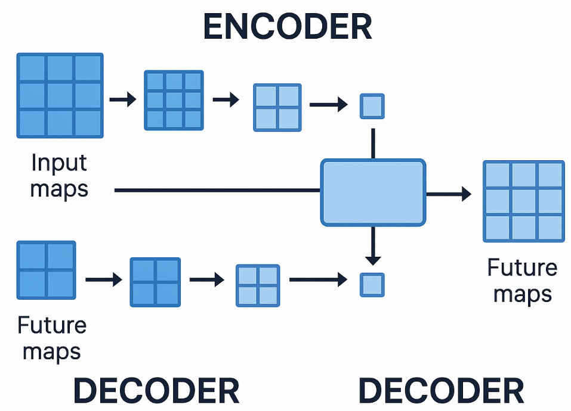
ConvLSTM Architecture for Prediction
Title: The "Sequence-to-Sequence" Model for Forecasting
Common Setup:
Encoder: A stack of ConvLSTM layers processes an input sequence of maps (e.g., the last 12 hours of rainfall data). It compresses the spatiotemporal information into a final "context vector.“
Decoder: Another stack of ConvLSTM layers takes this context vector and generates a new sequence of maps—the forecast (e.g., the next 3 hours of rainfall).

Slide 39
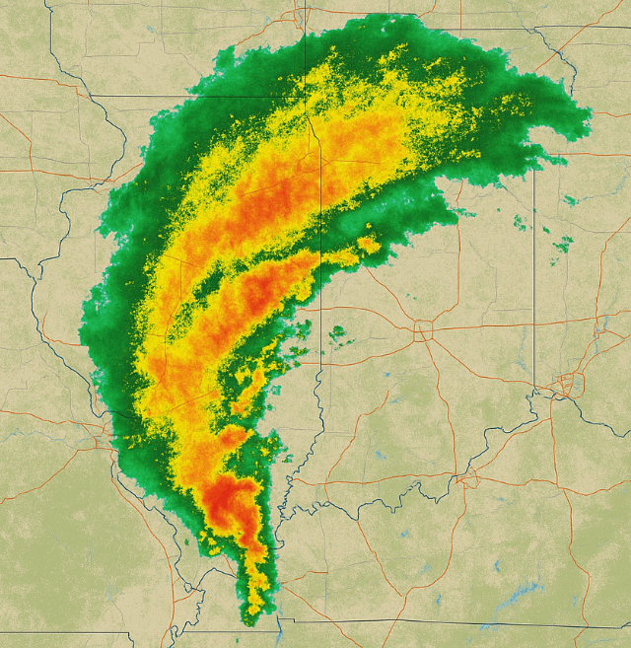
Application: Precipitation Nowcasting
Objective: To predict the intensity and movement of rainfall over the next 1-2 hours with high spatial resolution. This is critical for flood warnings and aviation.
Geo-Informatics Data: A time series of RADAR reflectivity maps, captured every 5 minutes. Each pixel in the map represents the intensity of rainfall.
Model: A ConvLSTM-based sequence-to-sequence model.
Input: The last 60 minutes of RADAR maps (12 frames).
Output: A prediction of the next 60 minutes of RADAR maps.

Slide 40
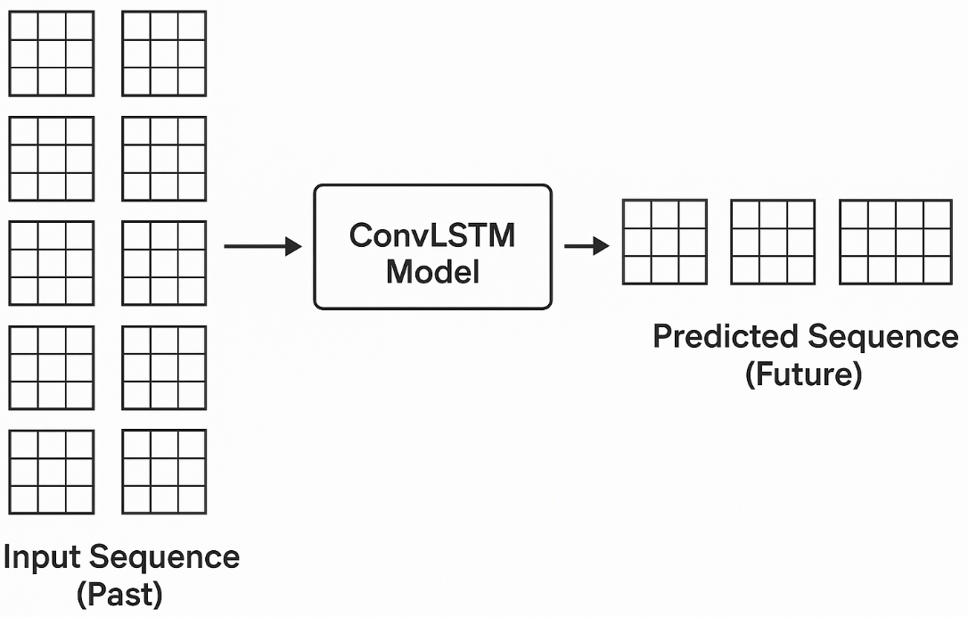
Case Study: Precipitation Nowcasting - The Task
Visualization of the problem:
(Diagram) A sequence of 10 small square maps is shown in a row, representing the input (t-9, ..., t-1, t). An arrow points from this sequence to a new sequence of 5 maps, representing the predicted output (t+1, ..., t+5).
The model must learn the complex physics of how storm cells move, rotate, and dissipate, just by watching sequences of pixel data.

Slide 41
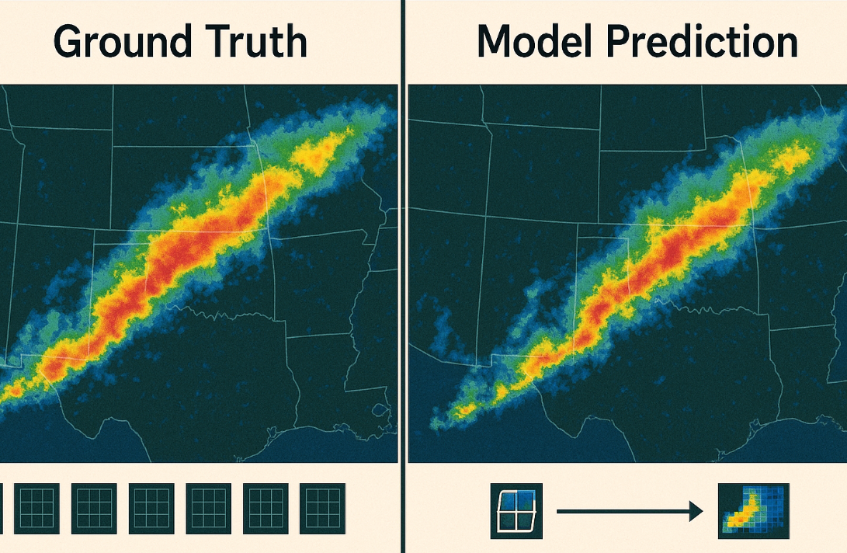
Case Study: Model Prediction vs. Ground Truth
Visualization: A side-by-side comparison for a single future time step.
Left: The ground truth RADAR map at time t+30 minutes.
Right: The ConvLSTM model's predicted RADAR map for t+30 minutes.
Interpretation: The model successfully captures the general movement and shape of the storm front but may struggle with the precise intensity or the formation of small, new storm cells. This highlights the model's strengths in learning motion and its limitations in predicting chaotic processes.

Slide 42
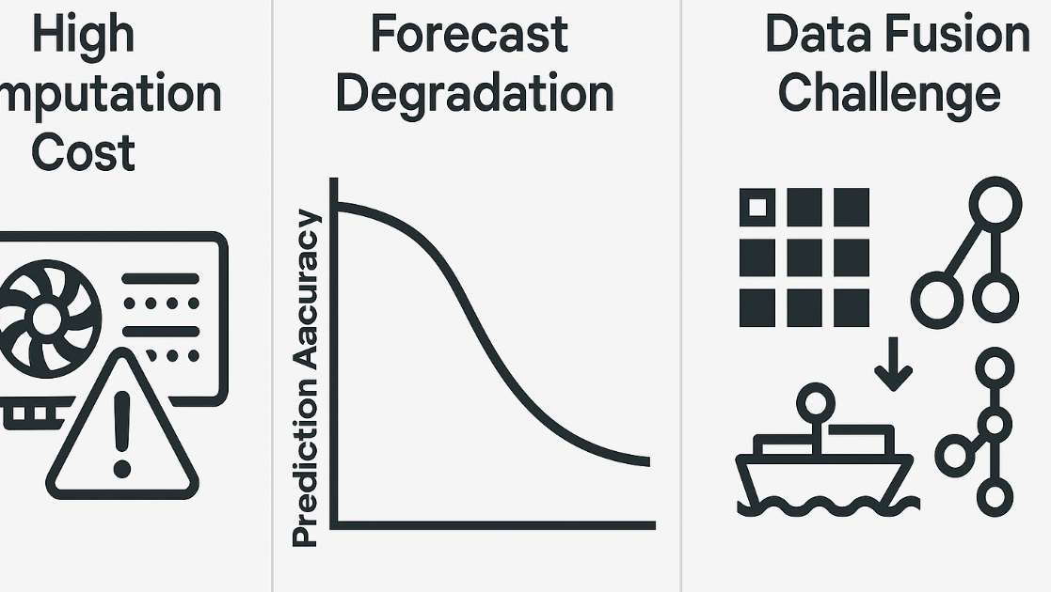
Challenges in Spatiotemporal Modeling
Challenge 1: High Dimensionality. The data is huge. A sequence of 10 maps, each 256x256, is over 650,000 data points per sample. This requires massive memory and GPU power.
Challenge 2: Long-Term Forecasting. The accuracy of these models degrades quickly over time. They are good at "nowcasting" (0-2 hours) but struggle with long-range forecasting due to the chaotic nature of systems like weather.
Challenge 3: Multi-Source Data Fusion. How do you effectively combine a RADAR map (grid), wind speed data from specific weather stations (points), and elevation data (static grid) into one coherent model? This is a major area of research.

Slide 43
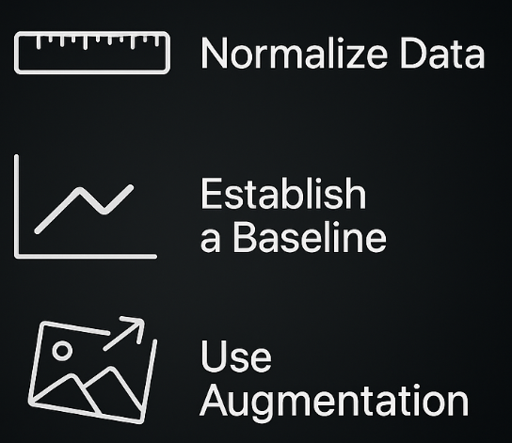
Best Practices for Spatiotemporal Data
Data Normalization: Scale pixel values (e.g., rainfall intensity) to a 0-1 range. This is even more critical for spatiotemporal models to ensure stable training.
Start Simple: Before building a complex ConvLSTM, establish a baseline. A simple baseline is the "persistence model," which predicts that the future map will be the same as the last seen map. Your deep learning model must significantly beat this simple heuristic.
Data Augmentation: While harder than for single images, you can still augment sequences by, for example, slightly rotating or shifting all frames in a sequence together.

Slide 44
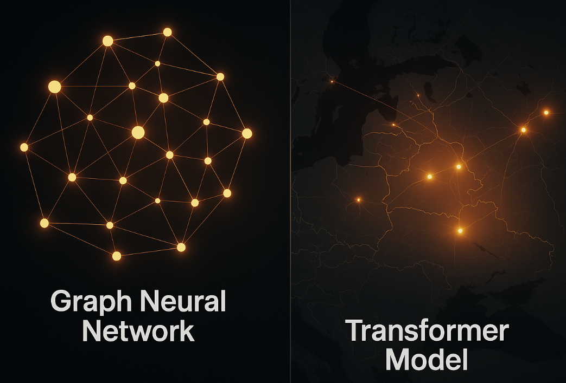
Beyond ConvLSTM: Other Architectures
Spatiotemporal Graph Neural Networks (ST-GNNs):
When to Use: When your spatial data is not a regular grid but an irregular network (a graph), like a road network or a sensor network.
How it Works: Models information flowing through the network nodes and edges over time.
Application: Predicting traffic speed at every major intersection in a city's road network.
Transformers for Spatiotemporal Data:
Concept: Using the powerful "attention" mechanism from Natural Language Processing to allow the model to learn which points in space and time are most important for making a prediction.

Slide 45

Case Study: Urban Planning - Air Quality Forecasting
Objective: Predict the concentration of pollutants (like PM2.5) across a city for the next 24 hours.
Geo-Informatics Data:
Hourly PM2.5 readings from a fixed network of monitoring sensors (a spatiotemporal graph).
Hourly gridded weather data (wind speed, direction) from a meteorological model.
Static data on the road network and locations of industrial polluters.
Model: A hybrid model that uses a Graph Neural Network to learn from the sensor network and a ConvLSTM to learn from the gridded weather data, fusing their outputs for a final prediction.

Slide 46
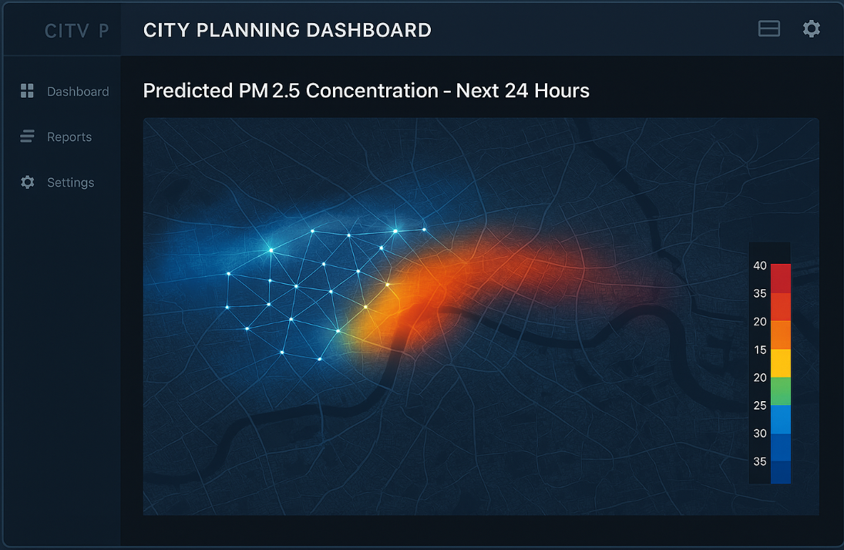
Case Study: Air Quality - Model Output
Visualization: An animated map of the city showing the predicted PM2.5 concentration for the next 24 hours.
Real-World Impact:
Allows the city to issue timely public health warnings.
Can be used to implement dynamic traffic management, rerouting vehicles away from areas predicted to have poor air quality.
Provides data-driven evidence for urban planning and environmental policy.

Slide 47
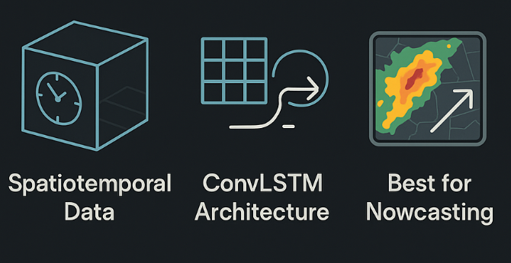
Summary of Spatiotemporal Modeling
Spatiotemporal models are essential for forecasting phenomena that evolve in both space and time.
The ConvLSTM is a foundational architecture that combines the spatial awareness of CNNs with the sequential memory of LSTMs.
These models excel at "nowcasting" tasks like precipitation prediction but face challenges with long-term forecasting and multi-modal data fusion.

Slide 48
Spatial Ensemble Methods

Slide 49
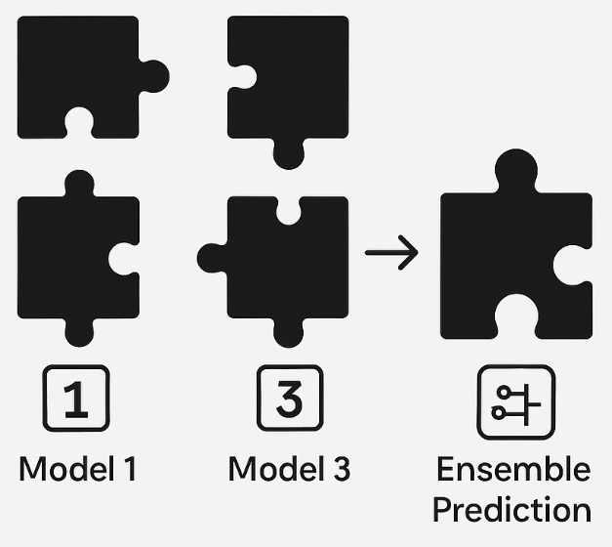
What is an Ensemble Method?
Definition: Ensemble methods are techniques that create multiple models and then combine their predictions to produce a final, improved result.
Why we learn this: Ensembling is one of the most powerful techniques for boosting the accuracy and robustness of any machine learning model. It can often turn a group of "good" models into one "excellent" model.
Goal: To reduce the overall error of our predictions by combining models that make different kinds of mistakes.

Slide 50
The Key to a Good Ensemble: Diversity
An ensemble is most effective when the models within it are diverse. This means they should be different in some way, so they don't all make the same errors.
How to achieve diversity:
Use different algorithms: Combine a Deep Learning model with a Random Forest and a Support Vector Machine.
Use different training data: Train the same algorithm on different subsets of the data (this is the basis of Bagging).
Use different features: Train the same algorithm on different subsets of the input features.

Slide 51
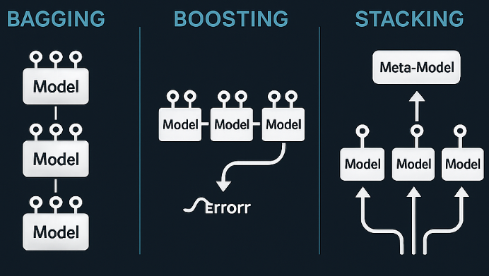
Ensemble Techniques We Will Cover
Bagging (Bootstrap Aggregating): Aims to reduce variance. Excellent for complex models that are prone to overfitting (like deep decision trees). Random Forest is a special type of bagging.
Boosting: Aims to reduce bias. Builds models sequentially, where each new model focuses on correcting the mistakes of the previous one.
Stacking (Stacked Generalization): Trains a "meta-model" to learn the best way to combine the predictions from several base models.

Slide 52
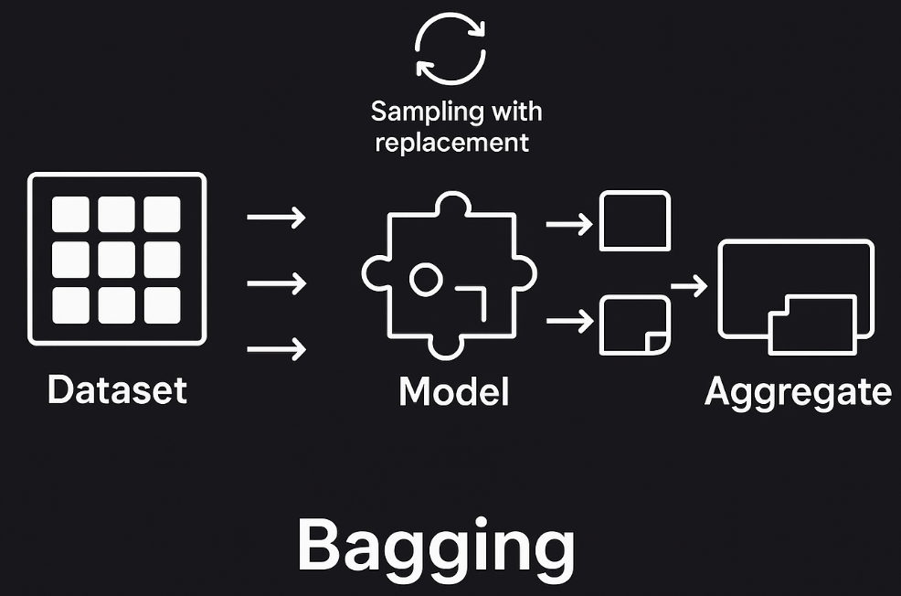
Deep Dive: Bagging
Concept: Bagging involves creating multiple copies of the training dataset using bootstrapping (sampling with replacement).
The Process:
Create n different bootstrap samples from your original dataset.
Train n separate models, one on each bootstrap sample.
For a new data point, get a prediction from all n models.
Aggregate the predictions: by averaging (for regression) or majority vote (for classification).
Why it's "Spatial": We apply this to our spatial models, using datasets rich with spatial features.

Slide 53
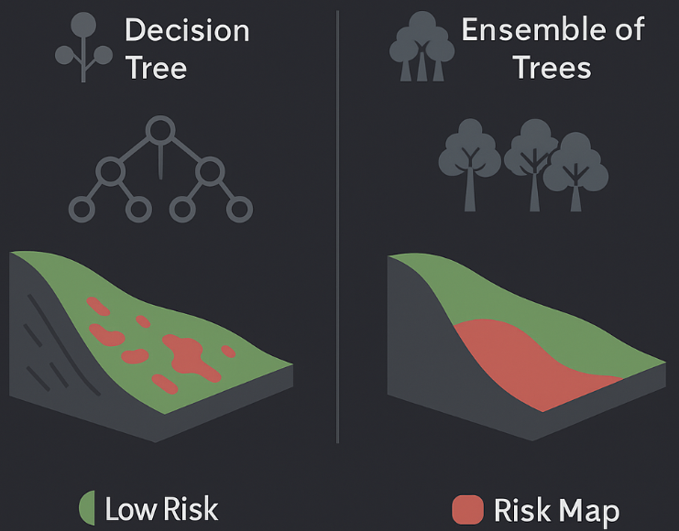
Application of Bagging: Soil Stability Classification
Geo-Informatics Data: A dataset of soil sample locations with attributes like clay_content, organic_matter, slope, and soil_moisture (from a SAR image). The task is to classify each location as 'Stable' or 'Prone to Landslide'.
Method: We can train a bagged ensemble of 50 deep decision tree models. Each tree is trained on a different bootstrap sample of the soil data.
Benefit: A single deep decision tree might overfit to noise in the data. The bagged ensemble averages out these idiosyncrasies, resulting in a more stable and reliable prediction map of landslide risk.

Slide 54
Deep Dive: Boosting
Concept: Boosting builds a sequence of models, where each model is a "weak learner" (only slightly better than random chance). Each subsequent model pays more attention to the data points that the previous models misclassified.
The Process (Conceptual):
Train a simple model (Model 1) on the data.
Identify which data points Model 1 got wrong. Increase their "weight" or importance.
Train Model 2, forcing it to focus on the high-weight (previously wrong) points.
Repeat, creating a sequence of models that are experts on the hardest cases.
The final prediction is a weighted average of all models.

Slide 55
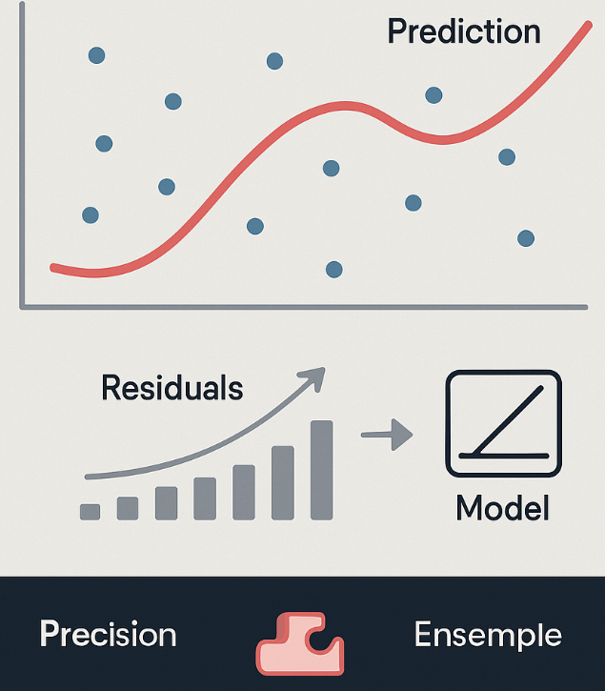
Gradient Boosting and XGBoost
Gradient Boosting: A modern, powerful implementation of the boosting idea. Instead of just re-weighting points, each new model is trained to predict the residual errors of the previous ensemble.
XGBoost (Extreme Gradient Boosting): A highly optimized, scalable, and popular library for gradient boosting. It is famous for winning data science competitions and is extremely powerful for tabular spatial data.
Why it's important: For many non-image spatial problems (like predicting property value from tabular features), XGBoost is often the highest-performing model available.

Slide 56
Application of Boosting: Flood Susceptibility Mapping
Geo-Informatics Data: A dataset of locations, some of which are known to have flooded ('Flooded'=1, 'Not Flooded'=0). Features include elevation, slope, distance_to_river, soil_permeability, and land_use_class.
Method: Use an XGBoost classifier. The model will sequentially build decision trees. Early trees might learn the obvious rule (elevation is low). Later trees will focus on the difficult cases: low-elevation areas that didn't flood, or high-elevation areas that did (e.g., due to poor drainage).
Benefit: Boosting excels at finding the complex, non-linear interactions between variables that determine flood risk.

Slide 57
Deep Dive: Stacking
Concept: Stacking (Stacked Generalization) is an ensemble technique that uses a new model (the "meta-learner") to learn how to best combine the predictions from a set of base models.
The Process (for Classification):
Split Data: Split the training data into folds (like in cross-validation).
Train Base Models: Train several different base models (e.g., a CNN, a Random Forest, an SVM) on the folds.
Create a New Dataset: Generate predictions from these base models. These predictions now become the input features for our new dataset.
Train Meta-Learner: Train a final, simple model (e.g., Logistic Regression) on this new dataset. This meta-learner's job is to figure out which base models to trust and how to combine their outputs.

Slide 58
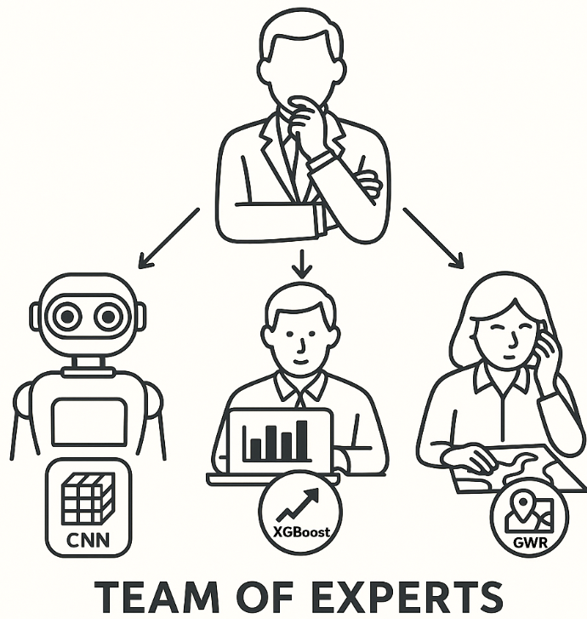
Why Stacking is Powerful for Spatial Data
Reason: Different models capture different types of patterns.
A CNN might be an expert at understanding the textural information from a satellite image.
An XGBoost model might be an expert at finding complex interactions in the tabular/vector features (e.g., elevation, distance to roads).
A GWR model could provide features about local non-stationarity.
The Meta-Learner learns to weigh their outputs intelligently. It might learn that for urban areas, the CNN's prediction is most trustworthy, but for rural areas, the XGBoost model's prediction is better.

Slide 59
Challenges and Best Practices for Ensembles
Challenge 1: Computational Cost. Training and running an ensemble of multiple complex models can be extremely time-consuming and expensive. Stacking is particularly intensive.
Challenge 2: Overfitting. It's possible for the meta-learner in stacking to overfit, especially if the base models are not diverse enough.
Best Practice: Spatial Cross-Validation. When creating the predictions for the meta-learner's training set, it is absolutely critical to use a proper spatial cross-validation scheme to prevent information leakage and get a realistic performance estimate.

Slide 60
Grand Case Study: Operation Snow Leopard
The Goal: Pinpointing Elusive Predators
Topic: Operation Snow Leopard: Creating a high-precision habitat suitability map for the endangered Snow Leopard (Panthera uncia) in the Himalayas.
Objective: Move beyond simple presence/absence mapping to create a probability surface that can identify potential conservation corridors between known populations.
Challenge: The species is extremely elusive, and the terrain is vast and rugged. Field surveys are difficult and expensive, making remote sensing and advanced modeling essential.

Slide 61
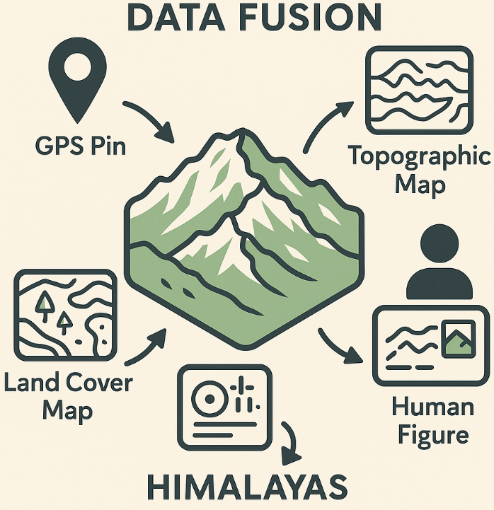
The Geo-Informatics Data Stack
Concept: We integrate multiple data sources to build a comprehensive environmental profile.
Data Layers:
Presence/Absence Points: Verified sightings and non-sighting survey locations (our target variable).
Topography (SRTM DEM): Elevation, Slope, and Ruggedness (terrain complexity). Snow Leopards prefer steep, rugged terrain.
Land Cover (ESA WorldCover): Land Cover Class (e.g., bare rock, sparse vegetation, snow). Identifies hunting grounds.
Human Influence (Global Human Footprint Index): Distance to Roads, Distance to Settlements. A proxy for human disturbance, which they avoid.

Slide 62
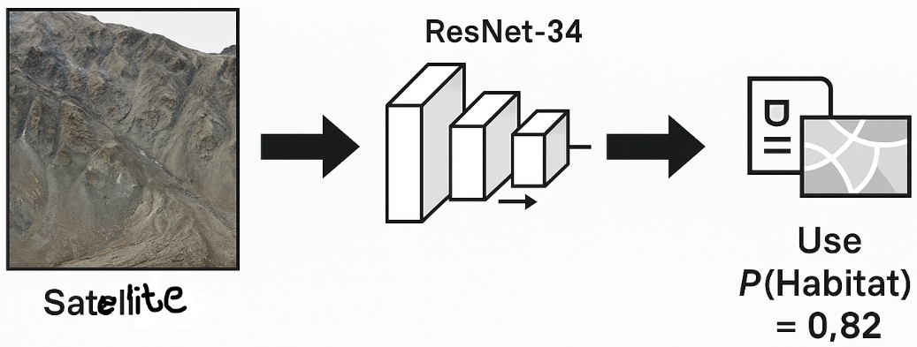
Base Model 1: The Visual Analyst (CNN)
Model: A ResNet-34 Convolutional Neural Network.
Input: For each presence/absence point, we extract a 256x256 pixel satellite image patch (using the RGB bands) centered on that point.
Task: The CNN learns to identify the visual textures and patterns associated with Snow Leopard habitat. It learns what "good terrain" looks like (e.g., complex rock formations, sparse vegetation, lack of human structures).
Output: For each point, a probability (0.0 to 1.0) of it being a suitable habitat based on visual context.

Slide 63
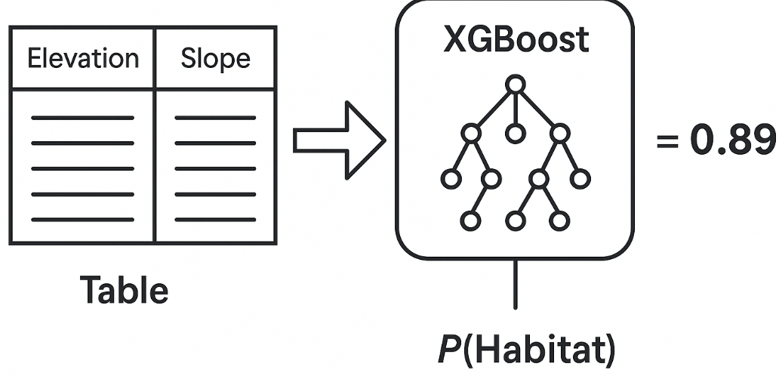
Base Model 2: The Environmental Analyst (XGBoost)
Model: An XGBoost (Extreme Gradient Boosting) classifier.
Input: For each presence/absence point, we extract a vector of tabular data:
Elevation = 4500m
Slope = 35 degrees
Distance_to_Road = 15 km
Ruggedness_Index = 0.78
Task: The XGBoost model learns the complex, non-linear relationships between these environmental variables and the presence of Snow Leopards.
Output: For each point, a probability (0.0 to 1.0) of it being a suitable habitat based on its environmental characteristics.

Slide 64
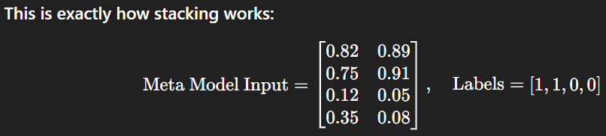
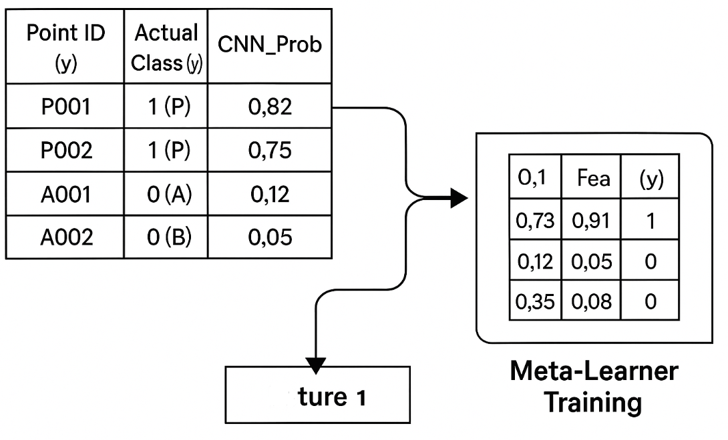
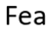
The Calculation: Creating the Meta-Learner's Dataset
Concept: We now use the predictions from our two "expert" base models to train a final "manager" model. The predictions become the new features. This is the core of stacking.
Process (using Spatial Cross-Validation): We generate out-of-sample predictions for every point in our dataset. These predictions form a new, simple training dataset.
Point ID | Actual Class (y) | CNN Probability | XGBoost Probability
P001 | 1 | 0.82 | 0.89
P002 | 1 | 0.75 | 0.91
A001 | 0 | 0.12 | 0.05
A002 | 0 | 0.35 | 0.08

Slide 65
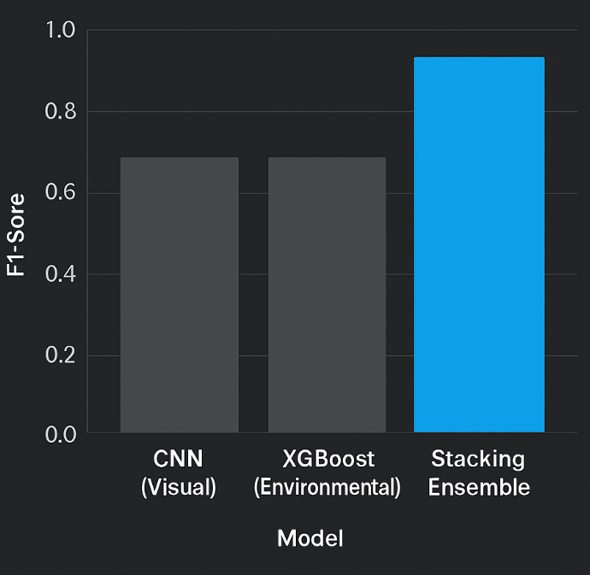
Training the Meta-Learner & Final Results
Meta-Learner: We train a simple, interpretable model like Logistic Regression on the new dataset from the previous slide. Its job is to learn the optimal weights to assign to the CNN and XGBoost predictions.
Interpretation: The meta-learner might learn that if the XGBoost model is very confident (Prob > 0.9), its prediction should be trusted heavily. But if the XGBoost model is uncertain (Prob ~ 0.5), it should pay more attention to the CNN's visual analysis.

Slide 66
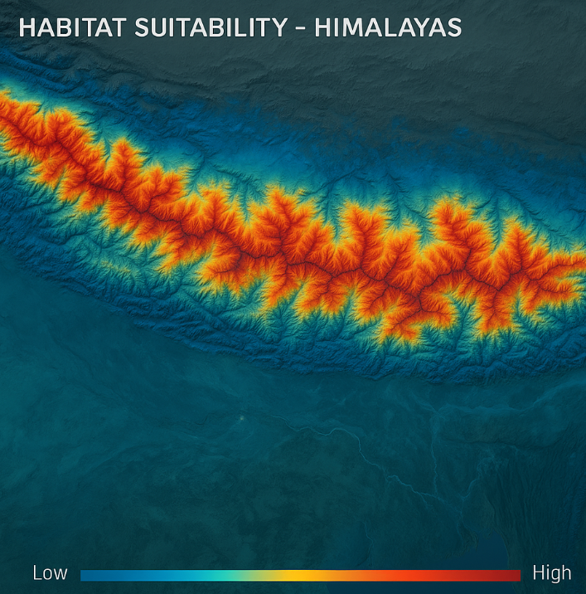
The Final Product: A Nuanced Suitability Map
Process: To create the final map, we run our entire ensemble pipeline on every single pixel of the study area.
Output: The result is not just a binary map, but a continuous probability surface from 0.0 to 1.0.
Advantage: This is far more useful for conservation. It allows planners to distinguish between "good" (0.7 prob) and "excellent" (0.95 prob) habitat. The "excellent" areas can be prioritized for protection, while the "good" areas might form the basis for conservation corridors.

Slide 67
From Model to Mission: Real-World Impact
Summary: The stacking ensemble provided a significant boost in accuracy, creating a more reliable tool for conservation planning.
Actionable Insights:
Identify Core Habitats: The highest probability areas are designated for strict protection and anti-poaching patrols.
Map Conservation Corridors: Planners can use the map to identify the most likely paths for Snow Leopards to travel between core habitats, guiding infrastructure development (e.g., where not to build a road).
Focus Community Engagement: Work with communities living near moderate-to-high suitability zones to reduce human-wildlife conflict.

Slide 68
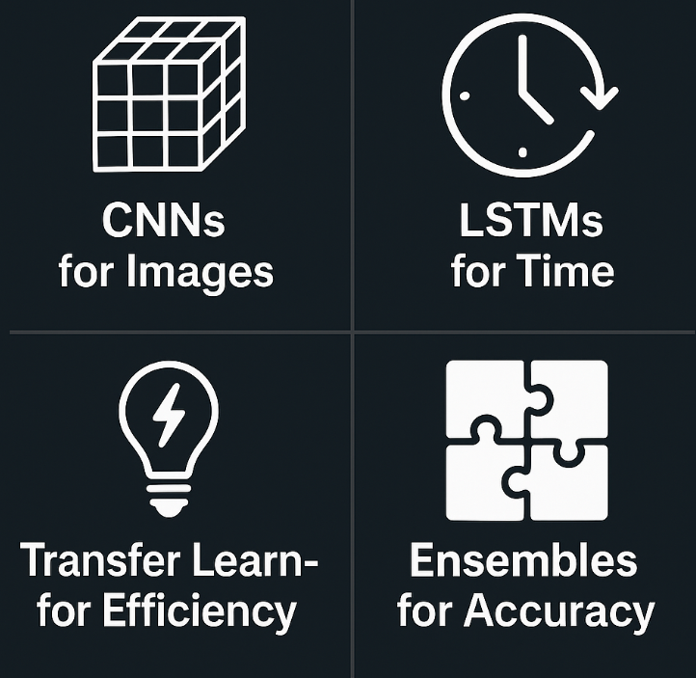
Chapter 4 Summary and Conclusion
Deep Learning automates feature extraction, unlocking patterns in complex spatial data like imagery (CNNs) and time series (LSTMs).
Transfer Learning is a crucial technique for applying DL to geo-informatics by leveraging pre-trained models, saving time and data.
Spatiotemporal Models (ConvLSTM) are designed to learn from sequences of maps to make spatial forecasts.
Ensemble Methods (Bagging, Boosting, Stacking) combine multiple models to improve accuracy and robustness, representing the peak of predictive performance.

Slide 69
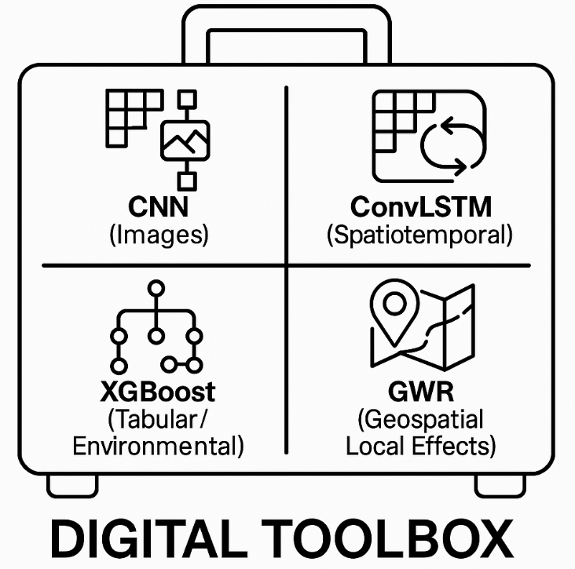
The Geo-Informatics Engineer's Deep Learning Toolkit
When you have gridded/image data... think CNNs & Transfer Learning.
When you have a time series of maps... think ConvLSTM.
When you have tabular data with spatial features... think XGBoost.
When accuracy is the absolute top priority... think Stacking Ensembles.

Slide 70
Final Challenges & The Future
The Future is Hybrid: Combining physical models (like climate models) with deep learning.
The Future is Explainable (XAI): Developing methods to understand and trust our complex spatial models.
The Future is Big Data: Scaling these techniques to work on continental or planetary-scale datasets.

Slide 71
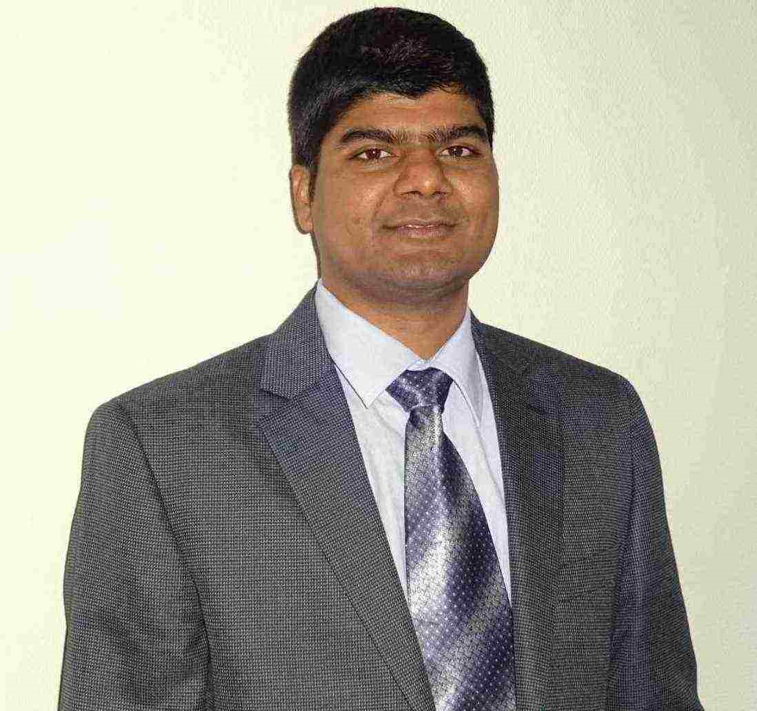
Myself
Dr. Giri Rajasekhar Gunnu
AI, Digital Twin & Industry Solutions Specialist | Industry 4.0 Specialist | Predictive Solutions Expert | Marine and Offshore Consultant
Professor of Practice, Andhra University
📧 g.giri.iitm@gmail.com
🔗 LinkedIn: girigunnu

Slide 72
Q&A
Welcome your questions and insights from all ranks
Your feedback helps us improve our CBPM implementation and ensures it meets the real-world needs of our fleet

